Slide 1
Elementary Instructional Material Adoption Committee
Leah Bauman, Cheryl Ann Daniels, Eric Danielson, Kim Knudson
Kelly Miller, Rachel Oden, Lauren Powell, Aaron Reno. Karla Wiker

Slide 2
Evidence demonstrating student achievement
93% approval from staff

Slide 3


http://www.edreports.org
Notes:
Independent Reviews of Instructional Materials by Educators
EdReports.org is an independent nonprofit that publishes free reviews of instructional materials, using an educator-designed tool that measures alignment, usability, and other quality criteria. The reports help districts and educators make informed purchasing and instructional decisions that support improved student outcomes.
Each EdReports.org review process includes a gateway system to guide reviewers through the process. The EdReports.org’s tool supports a sequential review process through three gateways that reflect the importance of alignment to the fundamental design elements of the standards and then considers other high-quality attributes of curriculum as recommended by educators. Reviewers evaluate at least a year’s worth of core instructional materials.
A lot of research and effort goes into the creation of textbooks and digital products. EdReports.org’s tool evaluates these products from the end user’s perspective. We know when materials enter a classroom, teachers are looking for two key features:
First, is the instructional material aligned to the standards? Are all standards present and treated with appropriate depth and quality required to support students? Access to high-quality instructional materials helps students meet higher standards, enhances educator learning and saves teachers time. Aligned materials allow students to engage with texts, problems and assessments that build logically from year to year so that they graduate college- and career-ready.
Second, are the instructional materials usable for students and educators? Materials must be well designed to facilitate student learning and enhance a teacher’s ability to differentiate and build knowledge within the classroom. It also means that the materials offer assessments that help educators and parents focus on mathematical strengths and areas of growth, and incorporate technology effectively as a means to helping students learn.

Slide 4
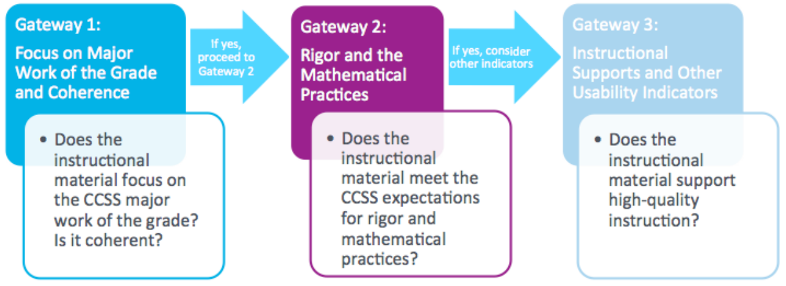
Gateway Evaluation Process

Slide 5
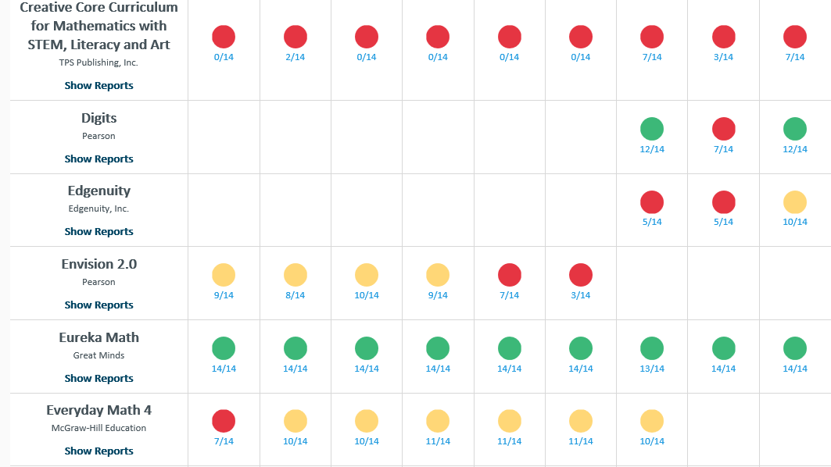

Slide 6
Grades K-5
Lesson Structure

Slide 8
Meeting the Needs of all Students

Slide 9
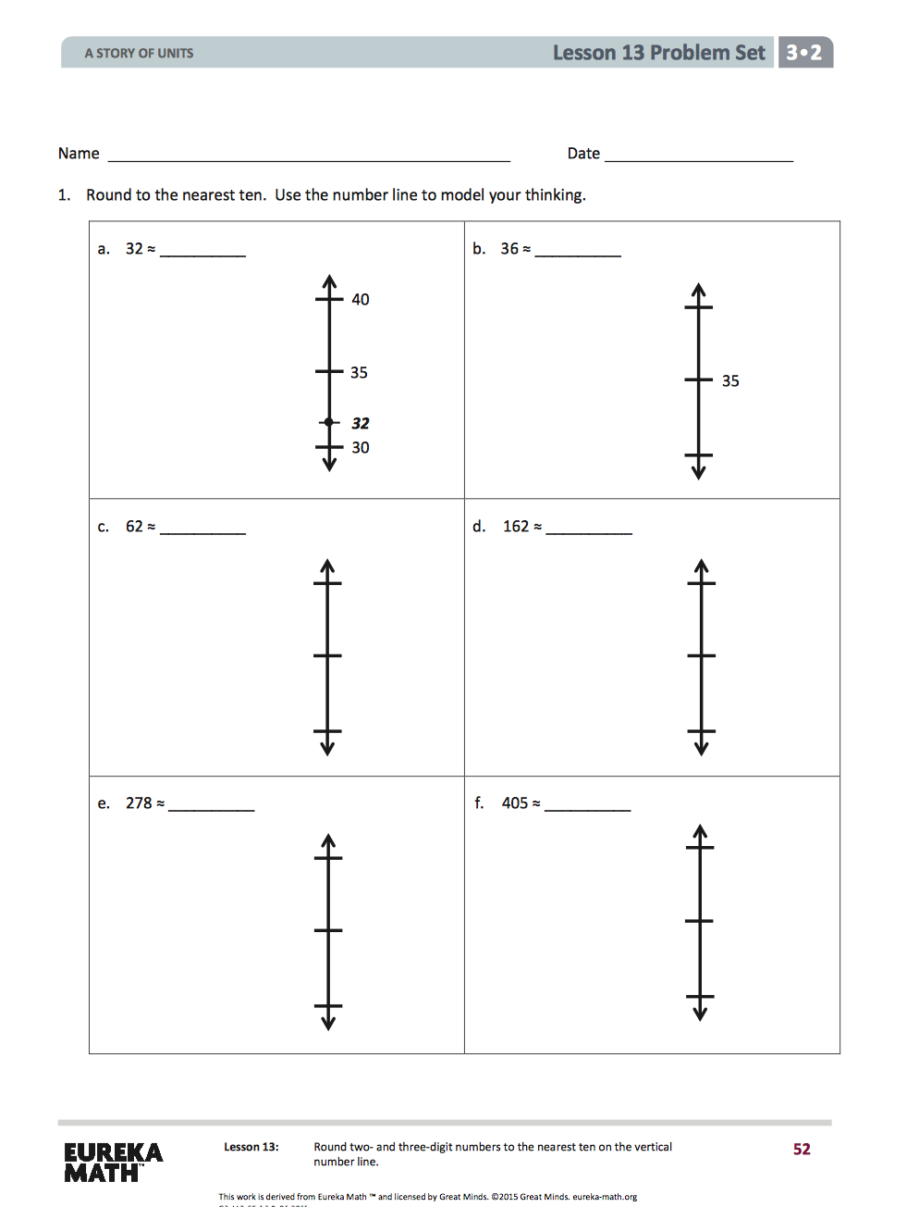

Slide 12
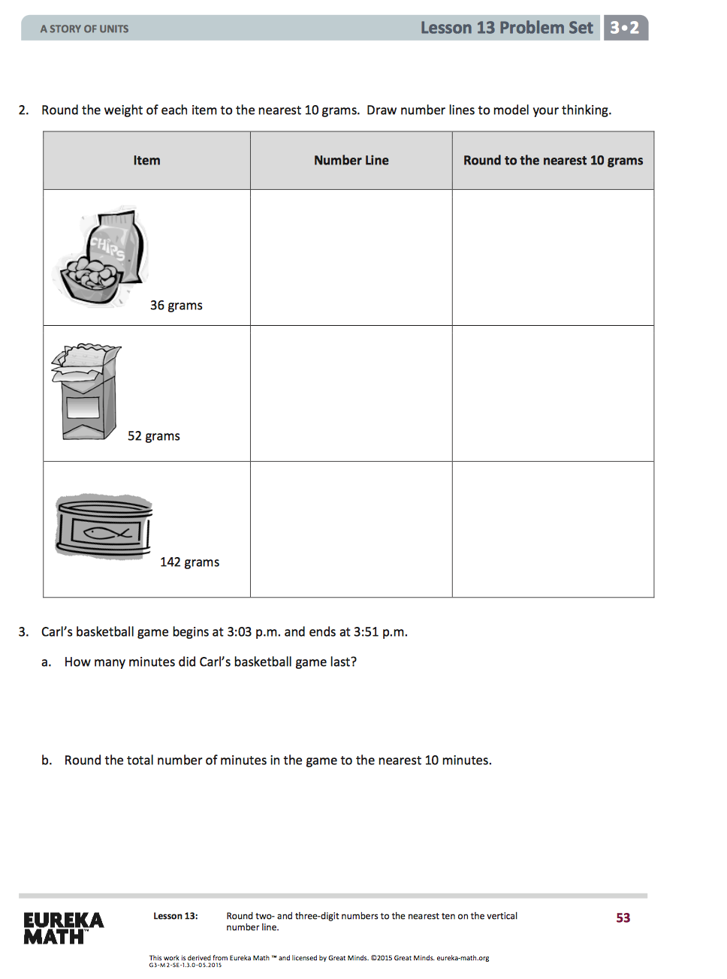

Slide 13
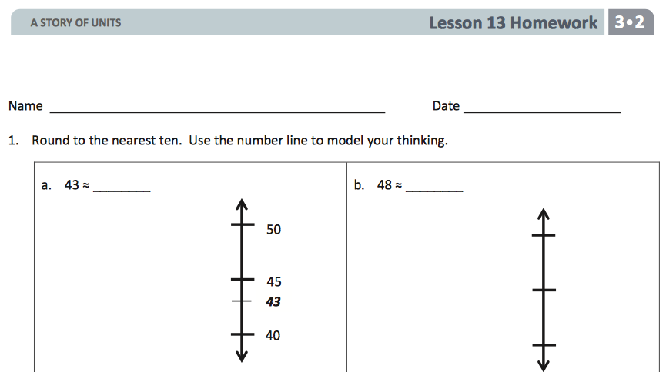
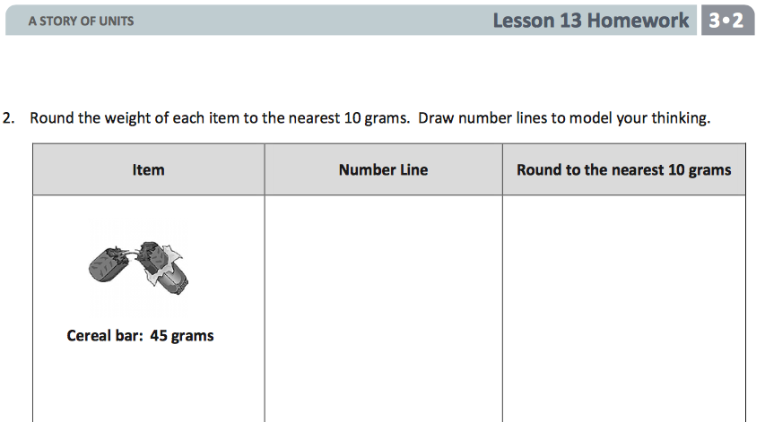

Slide 14
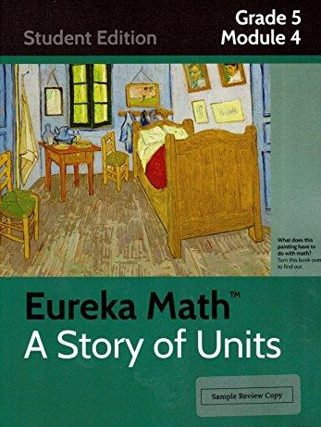
How Eureka Math specifically meets the needs of all students
Scaffolding integrated into each module
Alternative strategies for how students
  access information
  express and demonstrate learning

Slide 15
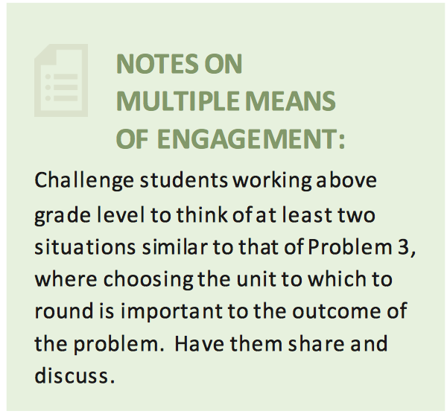
Margin Notes
Addresses needs presented by:
  English Language Learners
  Students with Disabilities
  Students performing below or
  above grade level
Notes:
Scaffolds: The scaffolds integrated into each Module gives alternatives for how students access information as well as express and demonstrate their learning. Margin notes are provided within each lesson and address many needs presented by English language learners, students with disabilities, students performing above grade level, and students performing below grade level.

Slide 16
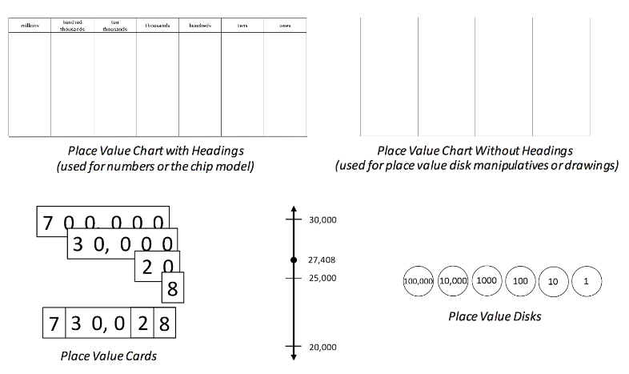
Multiple Representations
Number Lines
Personal white
boards
Place value cards
Place value chart
Place value disks
Tape diagrams

Slide 17
Naturally Differentiated Lesson
“Must Do” Problems
  Meets the objective
  Majority of the class
“Could Do” Problems
  Students with greater fluency and understanding
  Complete more work
“Challenge” Problems
  Motivating, especially for advanced students
  Opportunity to share problems with class
Notes:
At times, the lesson and Problem Set are appropriate for all students but at other times, they may need customizing. The Problem Sets are naturally differentiated. If the decision is to customize based on needs of students it is suggested to decide upon and designate “Must Do” “Could Do” and “Challenge” problems. “Must Do”
Problems that meet the objective and provide coherent experience for students. The majority of the class will complete the “Must Do” problems within the allocated time.
“Could Do”
These problems are for students who work with greater fluency and understanding therefore, complete more work within a given time frame.
“Challenge”
At times, a particular tricky problem might be designated as a “Challenge” problem. This can be motivating, especially for advanced students. Consider creating the opportunity for students to share these problems with the class.

Slide 18
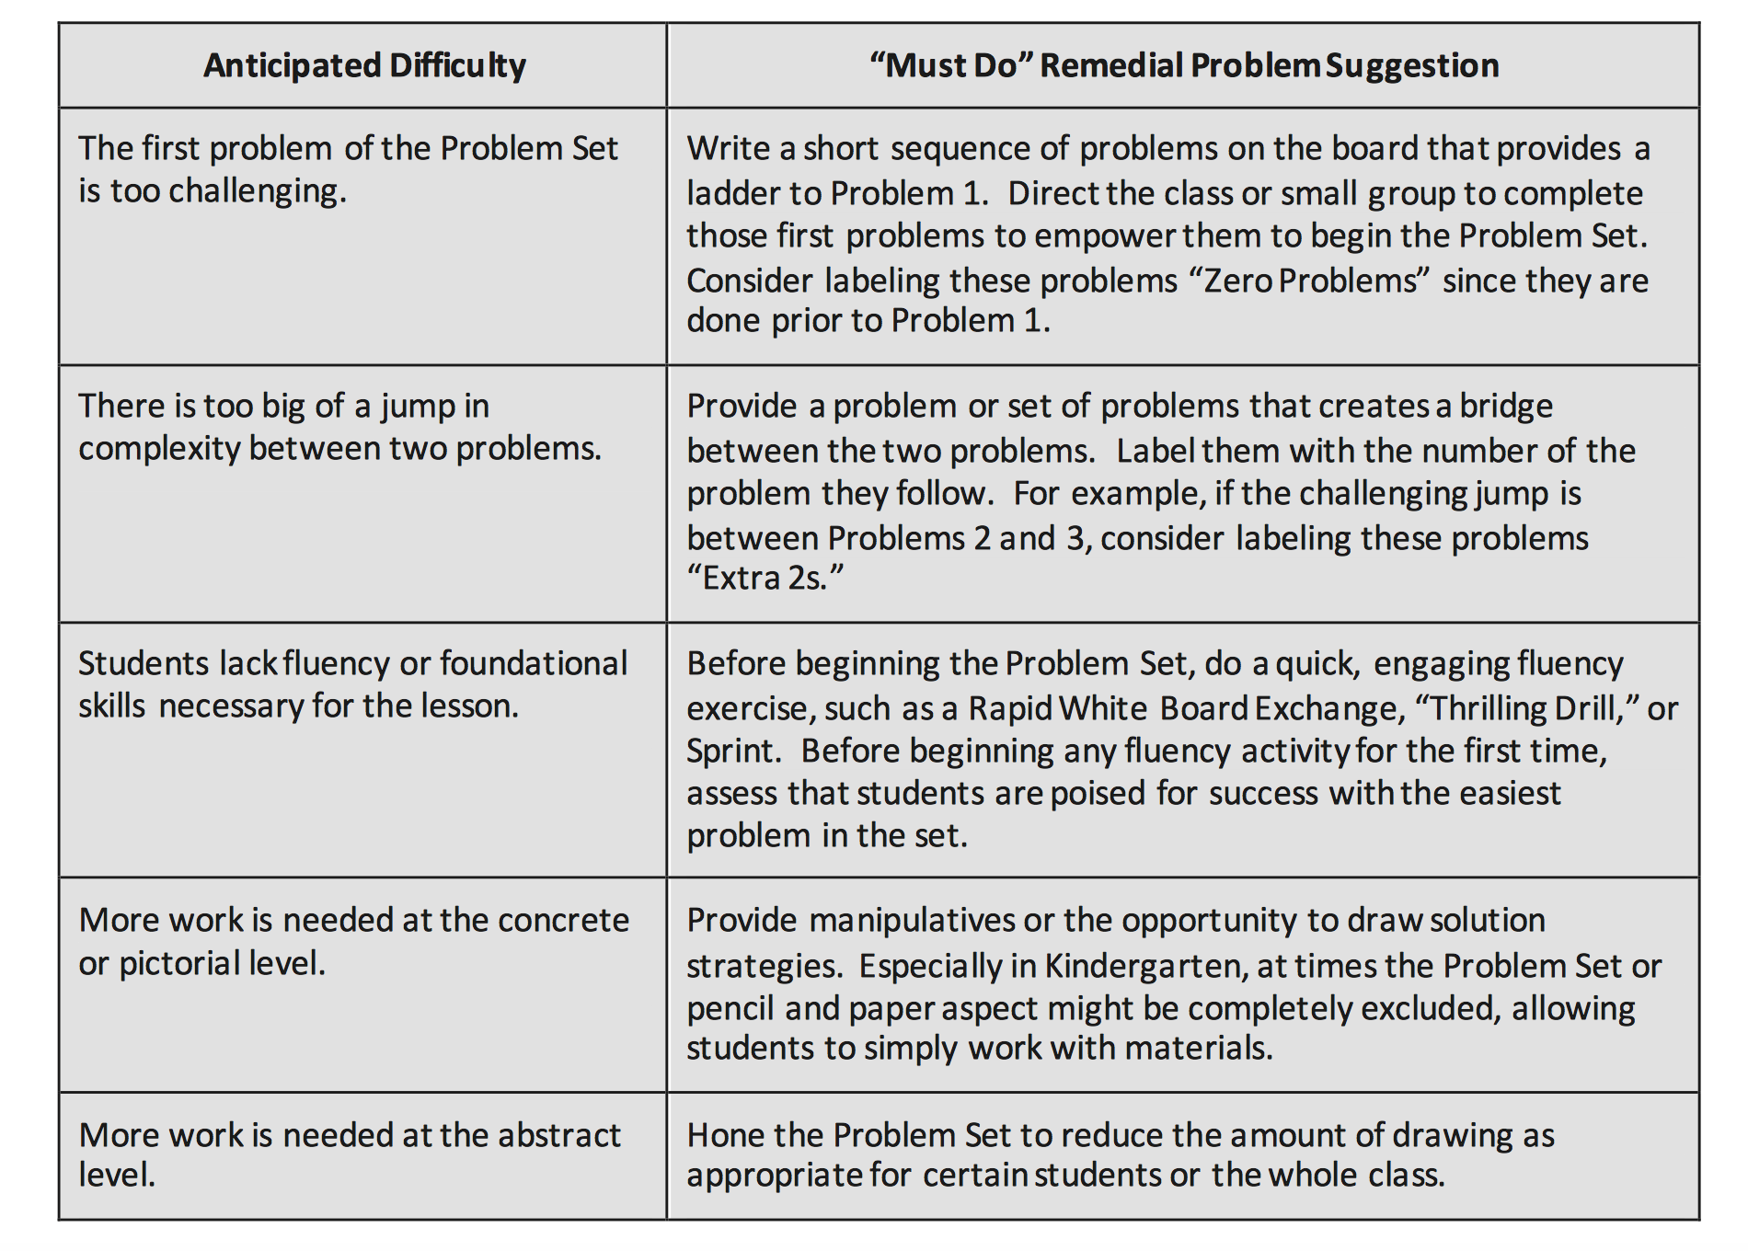
“Must Do” Problems
Remedial work
Whole class or small group
Individual students
Anticipated difficulties

Slide 19
K-5 Preparing for
Algebra Success

Slide 20
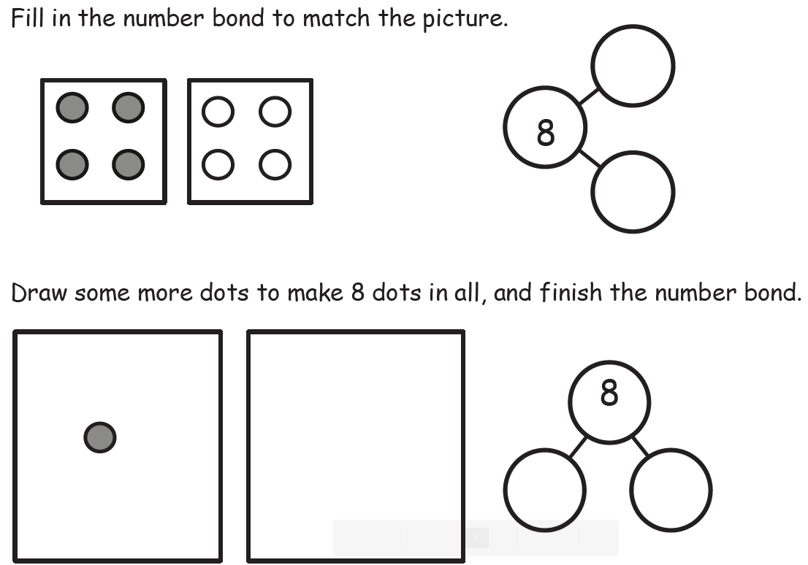

Slide 21
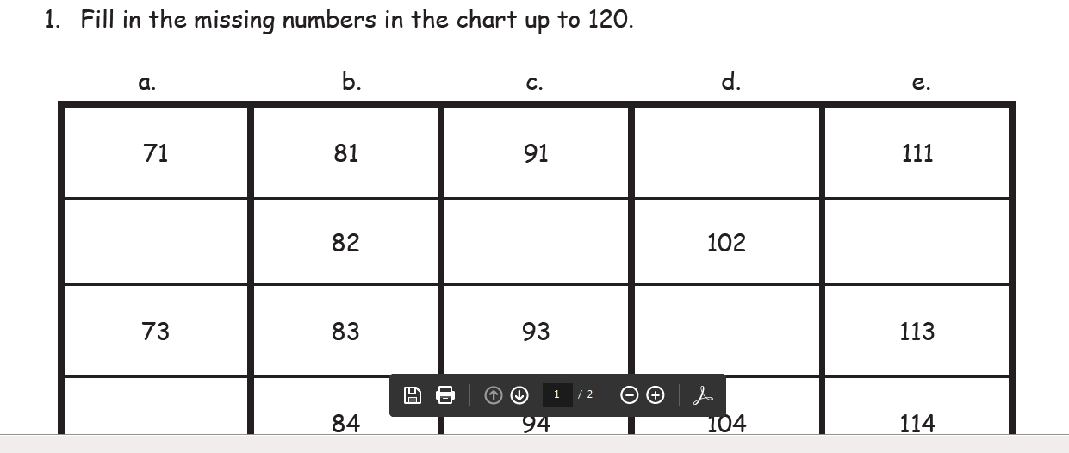

Slide 22
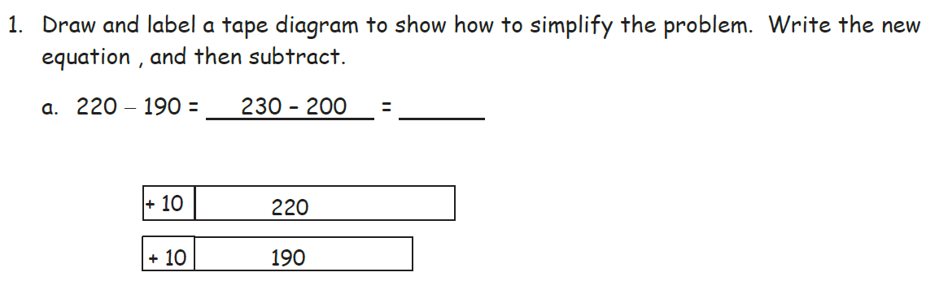

Slide 23
Tara buys 6 packs of printer paper. Each pack of paper costs $8.
Draw a tape diagram, and label the total amount she spends as m.
Write an equation, and solve for m.

Slide 24
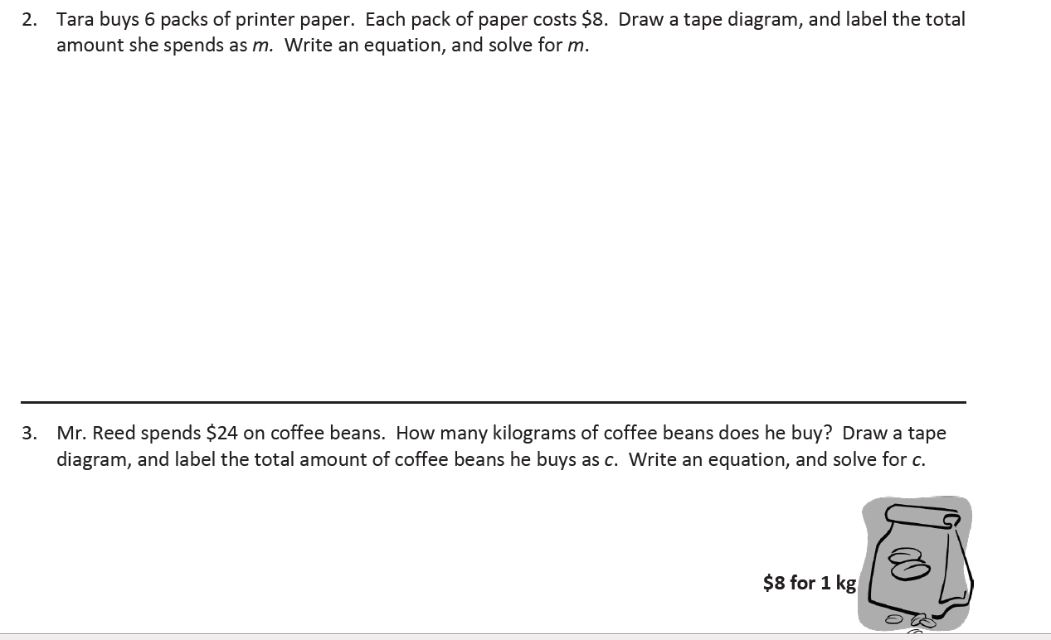
Mr. Reed spends $24 on coffee beans. How many kilograms of coffee beans does he buy?
Draw a tape diagram, and label the total amount of coffee beans he buys as c.
Write and equation, and solve for c.

Slide 26

5th Grade Module 1
Expanded form→ 30 x 10 + 5 x 1 + 2 x ( $\frac{1}{10}$ ) + 7 x ($\frac{1}{100}$ ) + 6 x ($\frac{1}{1000}$)
unit form→ 3 tens, 5 ones, 2 tenths, 7 hundredths, 6 thousandths
standard form→ 35.276
Notes:
The concept of a variable is woven into problems using expanded form. An example of this is the use of an exponent in expanded form. The exponent in this case functions as a “variable”.
3 x ${10}^{3}$ + 4 x ${10}^{2}$ + 5 x ${10}^{1}$ = ____________

Slide 27
5th Grade Module 2
A pineapple is 7 times as heavy as an orange.
The pineapple also weighs 870 more grams
than the orange.
What is the total weight in grams for the
pineapple and the orange?

Slide 28
Support for Home
Parents and Students

Slide 29

Notes:
Parent Letter: reassures parents that even though Eureka math might be different from what they learned, it will teach students in a logical progression from concrete to pictorial to abstract.
Homework Helpers: provide step-by-step explanations using the same language that teachers use in classrooms, to help parents help their students with specific homework problems. The Homework Helpers have each Homework Set for each Lesson in each Module.
Module Math Tips for Parents : Each K-8 module has suggested strategies, models, vocabulary, and connections to previous lessons to help support parents at home.
Lesson Math Tips for Parents: defines lesson-specific vocabulary and uses examples from lessons to help families better explain mathematical concepts to students.

Slide 30
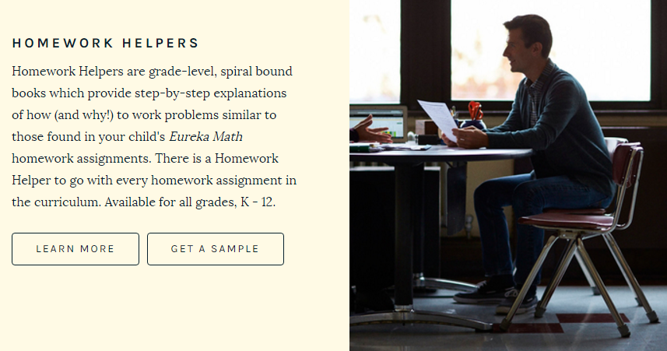

Slide 31


Slide 32


Slide 33

Grade Level Roadmaps
Grade specific
What your child will study
Learning strategies outside
the classroom
Bridging the gap between what was once taught

Slide 34


Slide 35

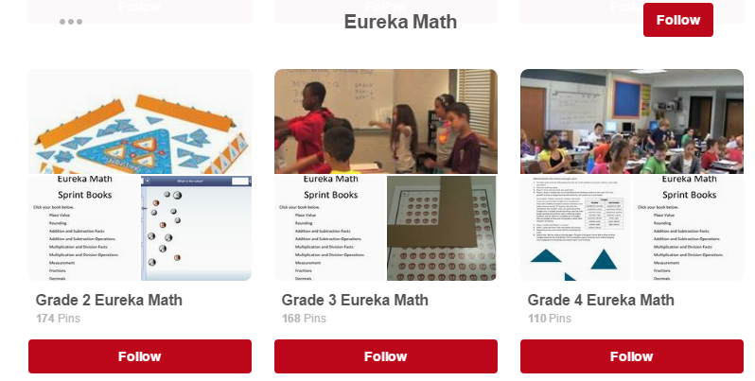

Slide 36

Free Resource for Parents

Slide 37
Elementary Instructional Material Adoption Committee
Leah Bauman, Cheryl Ann Daniels, Eric Danielson, Kim Knudson
Kelly Miller, Rachel Oden, Lauren Powell, Aaron Reno. Karla Wiker

